Slide 1
Introduction to FPGA Design In Quartus (REMOTE EDITION)
November 2020
Notes:
Welcome to Introduction to FPGA Design in Quartus. My name is Haley and I’m an FPGA engineer at Intel. FPGA stands for Field Programmable Gate Array and is a type of semiconductor that is very flexible and can be programmed for a wide range of applications. The term “field” refers to allowing the user to program and reprogram the device as opposed to in a semiconductor manufacturing plant and “gate array” refers to its regular repeating structure.

Slide 2
TOPICS
FPGAs at Intel
Fundamentals of Digital Electronics
FPGA Architecture
Intel® Quartus® Prime Design Software
FPGA Design Flow
Notes:
This course provides an overview of FPGAs and their design for someone who has an introductory understanding of electronic hardware such as binary and basic digital logic functions, but who is new to programmable logic.
We will discuss Intel’s relationship with FPGAs and some of the common applications where they are used today in order to give you a baseline for why it’s important to learn about designing programmable logic.
Next we will cover the fundamentals of digital electronics as it applies to FPGAs and a high-level overview of FPGA architecture.
In the final section of this course we will introduce you to Intel’s Quartus® Prime Design Software and the FPGA design flow so that you have everything you need to begin your own designs.

Slide 3
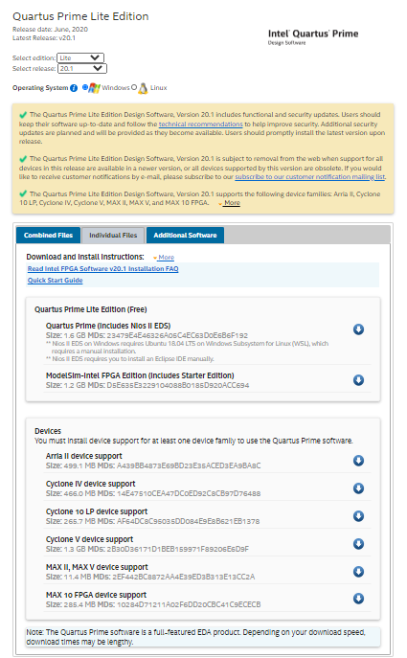
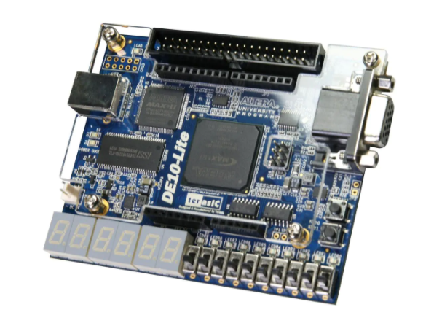
Companion Lab
Download the Quartus Prime Lite Software:
We will run with a remote DE10-Lite development board
Notes:
We strongly encourage you to practice the skills you learn today by completing the companion lab.
In order to do so, there are several steps you need to complete.
First, you will need to obtain a FPGA development kit. For beginners we recommend our most affordable board, the DE10-Lite, which can be purchased from Terasic.com for 85 dollars plus shipping. If you are affiliated with a university or other academic institution, you can purchase the board for a discounted academic price of 55 dollars plus shipping. You can also purchase these development boards from electronic distributors such as Digikey and Mouser.
Other Intel FPGA development kits will also work but you will need to adapt the device settings in the new project wizard and pin assignments to match your device when completing the lab.
Next, you can download the lab manual by clicking on the resources tab in the upper right hand corner of the course player window.
Also in the resources tab is a link to the downloads page where you can download and install Quartus Prime Lite Edition. This is the free version and has all the features necessary to complete the labs in our beginner curriculum.
Download and installation can take 1 hour or more depending on download speeds and other factors. Un-select all device support packages except the ones you intend to use in order to save time. Click “Download Selected Files” to begin installation. You can let the process run in the background while you view the rest of this training.

Slide 4





FIELD PROGRAMMABLE GATE ARRAY (FPGA)
Flexible, multi-functional reprogrammable silicon
Custom hardware functionality
Bare-metal speed and reliability
Truly parallel in nature
Notes:
FPGAs are popular because they offer greater throughput, execution speed, and energy efficiency than CPUs, the chips that power all laptops and desktops, but with the ability to adapt quickly to changes in algorithms, data patterns, or performance needs.
When you design an FPGA, you are designing custom hardware, an actual circuit, unlike writing software which is then run on a pre-designed circuit, such as your computer’s CPU. By working at the hardware level, you can reach speeds and power savings that are unattainable in software.
FPGAs are especially powerful for performing highly parallel tasks, where many calculations must occur simultaneously, because you can design different sections of the FPGA to complete each task.
Intel offers four families of FPGAs—MAX, Cyclone, Arria, and Stratix—of increasing capacity, speed, and feature sets to cover many different market segments and use cases. You can learn more about all of our FPGA products by going to Intel.com and looking for FPGA under the products tab.

Slide 5
Benefits of FPGA Technology
Flexibility
Time to market
Performance
Reliability
Long-Term Maintenance – reprogram if features change or bugs found
Many different applications – 5G, Data Center, Industrial, DSP
Excellent prototyping vehicle
Notes:
If you’ve heard of an ASIC, which stands for application specific integrated circuit, you might be wondering when you should use an FPGA instead of an ASIC for implementing a custom hardware design.
FPGAs are useful when you only need a few units of a custom chip, or when you want to regularly iterate on your design in frequent intervals. Their reprogrammable nature allows you, the designer, to avoid the costly and time-consuming process of manufacturing a custom chip. Assuming no design integrations, research shows that investing in ASIC design is only more cost effective if you are manufacturing them in high volume.
Even so, the production time for an ASIC can be quite lengthy, so it is becoming more common to use FPGAs in high volumes when you want the ability to regularly update your design. An example of this is in accelerating data centers where companies want to lead the industry by frequently improving upon their acceleration algorithms implemented in custom hardware.
If you are student, developer, or hobbyist, FPGAs allow for rapid prototyping, incremental design, and quick bug correction. There is also a growing availability of high level software tools and a decreased learning curve (for example, you don’t need to be an expert in place and route), and you can make use of prebuilt IP cores for common functions.

Slide 6















THE RISE OF NEW MARKETS
Notes:
As the internet of things draws more and more mobile and embedded devices together, huge new application spaces will form that require the connectivity and flexibility of FPGAs. The diversity will be amazing—from virtual reality goggles to continental power grids, from palm-sized drones to autonomous long-haul trucks.
Each application will mutate and evolve as it adapts to the omnipresent internet of things, the power of big-data computing and new use cases from endlessly creative users. Many of these new applications have diverse and unpredictable workloads.
In some cases the standards for these still-nascent markets are still evolving. Developing these kinds of products requires maximum programming flexibility, as well as high performance coupled with great energy efficiency.
It is crucial for the next generation of computer engineers to understand and be proficient in FPGA design.

Slide 7
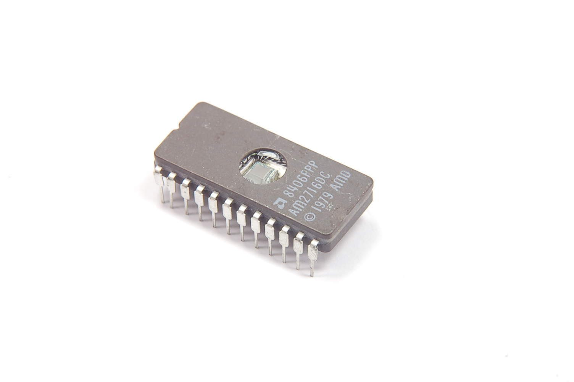
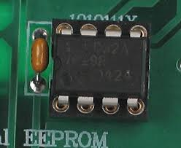
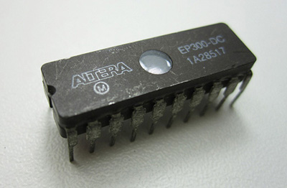
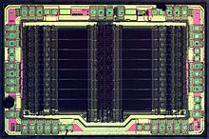
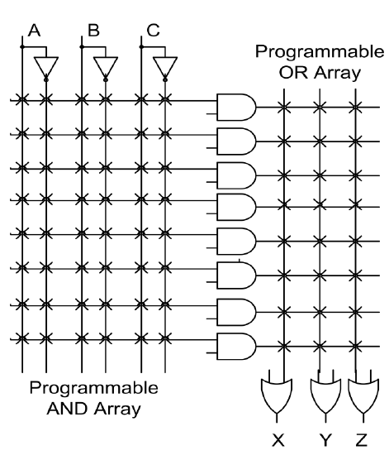


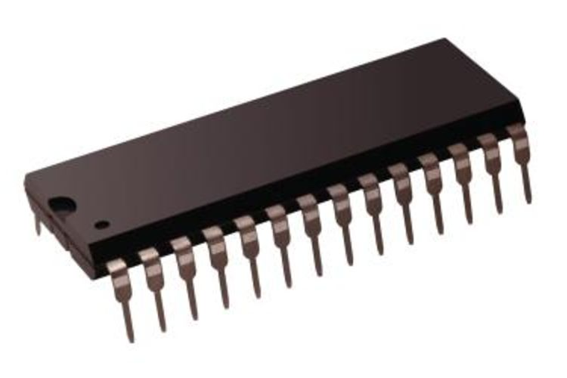
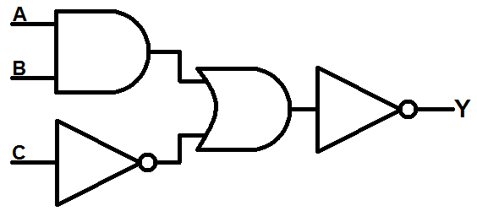
The BIRTH OF FPGAS
First EPROM; erased using UV light
EEPROM
First EPLD; re-programmable CMOS
High-density CPLD; full subsystems
1971
1983
1984
1988
1970
1975
1983
1985
1989
Altera launches first Integrated graphic design environment
First PROM; programmable, but permanent
Altera founded
First FPGA;
64 logic blocks w/ two three-input LUTs
First PLA; limited to sum of products
SOURCE: https://www.altera.com/about/company/history.html
Notes:
Before we dive into how FPGAs are designed, we have a brief history lesson.
As the computing industry demanded the flexibility of reprogrammable circuitry, there was a natural evolution from programmable read-only memory, or PROM, to erasable PROM, to programmable logic arrays, then electrically programmable and electrically erasable programmable logic devices, with the first FPGA launching in 1985.
Verilog, which we will learn more about soon, also appeared around the same time.
By 1989, Altera had launched the first integrated graphical design environment which combined schematic input, compilation, simulation and device programming all into a single tool, similar to the one you will learn to use in this course.

Slide 8
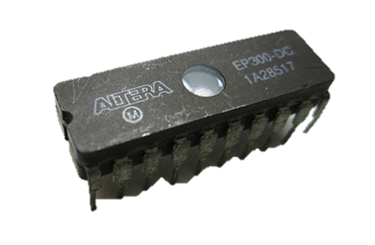
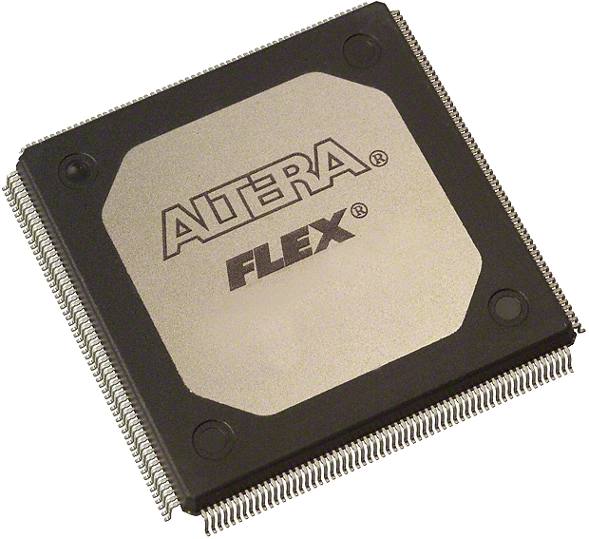

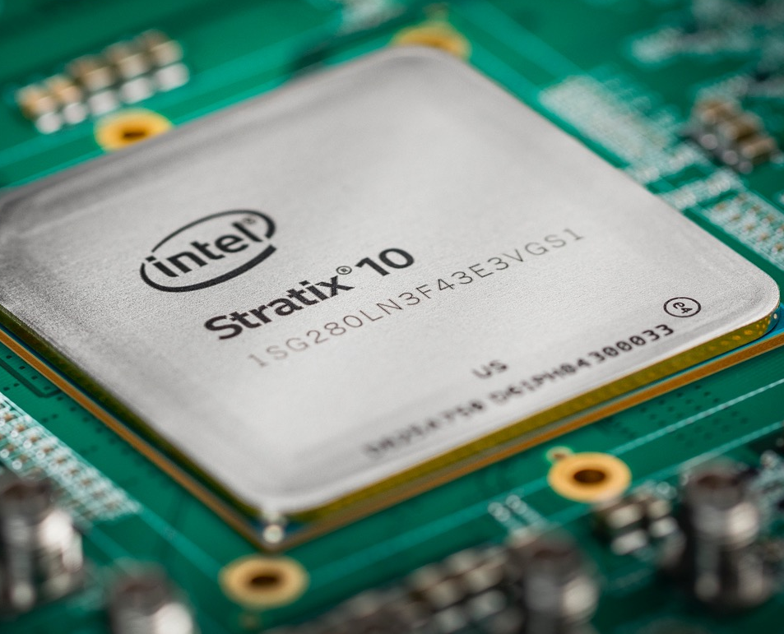
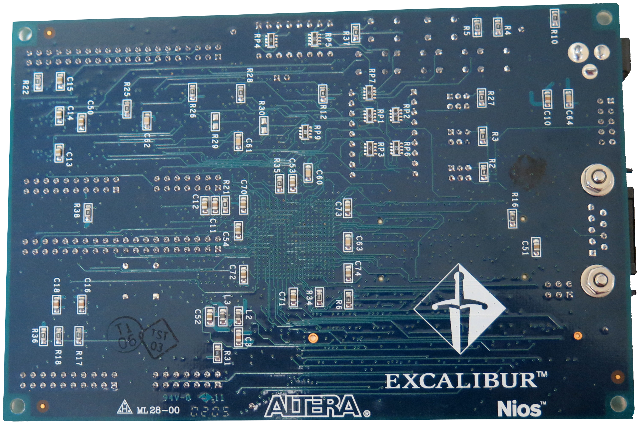
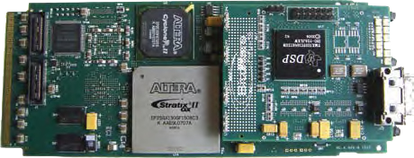

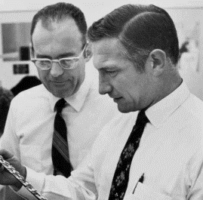
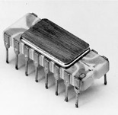

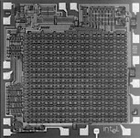


Intel’s deep history with fpgas
First embedded RAM
First soft micro-processor
First embedded DSP
SoC FPGA
System-in-Package (SIP)
Founded
First PLD
1983
1984
1995
2000
2002
2012
2016
//
//
1968
1971
1984
1994
2013
2015
Intel is founded by Robert Noyce and Gordon Moore
World’s first microprocessor
Intel and Altera establish a joint marketing agreement
Altera purchases Intel’s PLD business
Intel and Altera start foundry relationship for 14nm FPGAs and SoCs
Intel acquires Altera
Notes:
Intel has been around much longer than FPGAs and celebrated its 50th anniversary in 2018.
Shortly after Altera was founded in 1983, Intel partnered with them to jointly market microprocessors and programmable devices alongside one another.
There was some trading back and forth of different business units over the years which culminated in Intel acquiring Altera in 2015. Now, the FPGA business is fully integrated with Intel’s client, data center, and software businesses which allows for unique products designed perfectly for accelerating artificial intelligence, powering the Internet of Things, and big-data analytics.

Slide 9
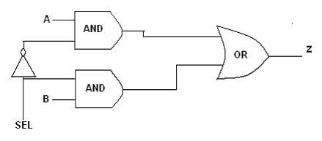
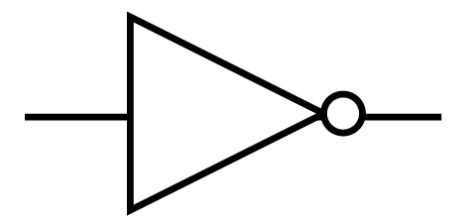
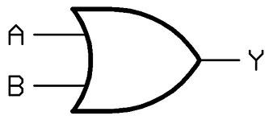
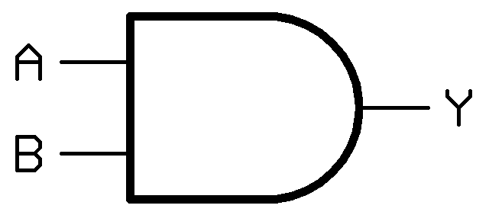
Back to the BASICS
S | A | B | Z
0 | 0 | 0 | 0
0 | 0 | 1 | 0
0 | 1 | 0 | 1
0 | 1 | 1 | 1
1 | 0 | 0 | 0
1 | 0 | 1 | 1
1 | 1 | 0 | 0
1 | 1 | 1 | 1
A | B | Z
0 | 0 | 0
0 | 1 | 1
1 | 0 | 1
1 | 1 | 1
A | B | Z
0 | 0 | 0
0 | 1 | 0
1 | 0 | 0
1 | 1 | 1
A | Z
0 | 1
1 | 0
2:1 MUX
Z = (~S & A) | (S & B)
Inverter
Z = ~A
OR
Z = A | B
AND
Z = A & B
Notes:
In order to truly understand how FPGAs work, it helps to go back to the fundamentals of Boolean logic. Hopefully this is something you have learned in an Intro to Computer Engineering type of course and this is just a review. If these concepts are unfamiliar, it might be worth researching further and there are many free guides online.
First you have an inverter, where the output of the input. Then you have an OR function, where the output is true when any or all of the inputs are true. Lastly you have a AND function, where the output is true only when all of the inputs are true.
From these three functions we can build a 2 to 1 mux, or multiplexor, sometimes referred to as a selector. By introducing a third input, the select bit, shown in our truth table as the letter S, we have created a logic unit that ‘selects’ either input A or input B to pass to output Z. In this function, regardless of the value of B, Z equals A whenever S is 0 (as shown in the first 4 rows of the truth table) and regardless of the value of A, Z equals B whenever S is 1 (as shown in the last 4 rows of the truth table).

Slide 10
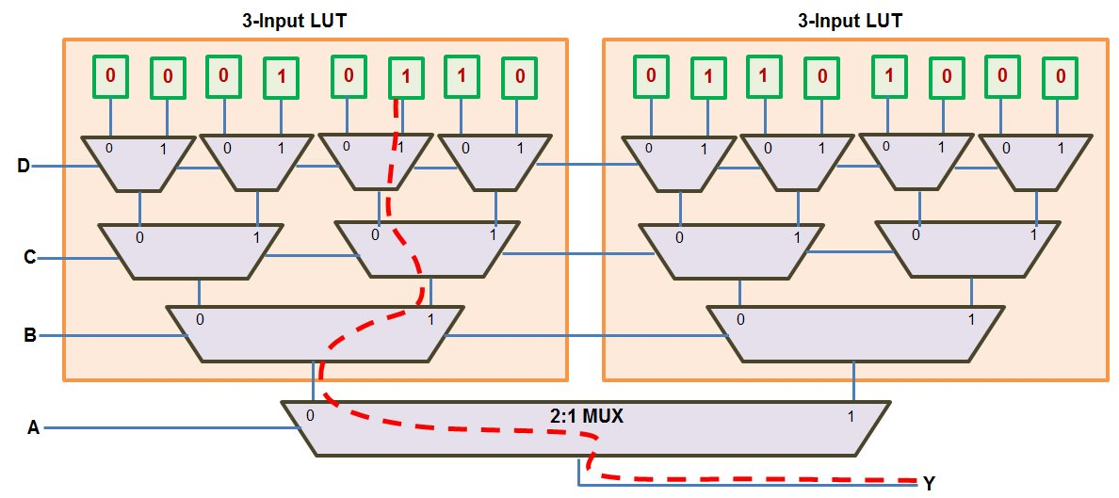
Look-Up Table (LUT): THE FOUNDATION
Notes:
By using an array of many 2 to 1 muxes, we can build what is called a look-up table, or LUT. The logic is called a lookup table because the output is selected by “looking up” the correct programmed level and routing it through the multiplexers based on the LUT input signals.
This example is of a 4-input LUT, which is actually built by muxing the outputs of two 3-input LUTs. Each tier of the design aligns with a different input, A, B, C, or D. It is important to note that the inputs to a LUT function are used as the select bits for the cascaded muxes.
Let’s walk through an example to understand how it works.
The green boxes at the top of this diagram correspond to various signals from other parts of our design. Here we have 16 of them and we can imagine them being numbered 0 to 15. Therefore, with just one 4-input LUT we can design a circuit that selects any one of those signals to get passed to our output, Y.
Each entry is coded as 4-bit Boolean with A, B, C, and D representing each of the bits.
If you follow the red path in reverse from bottom to top, you will see by setting bit A to 0, bit B to 1, bit C to 0 and bit D to 1, we get the 6th green box. So the input code 0101 corresponds to a 1 being passed to output Y. If you are familiar with Boolean counting, you will recognize that 0101 represents the number 5, which is the 6th value in a number sequence beginning with 0. Similarly, to get the first box, we would have code 0000, and to get the last box we would have code 1111, which is 15 in Boolean. Therefore, by using just 4 select bits, you can create any logic you need. The path show here corresponds to “not A” and B and “not C” and D.
As a designer using the Quartus Prime tools, you will be able to see which logic function Quartus Prime assigned to a particular lookup table in your design.

Slide 11
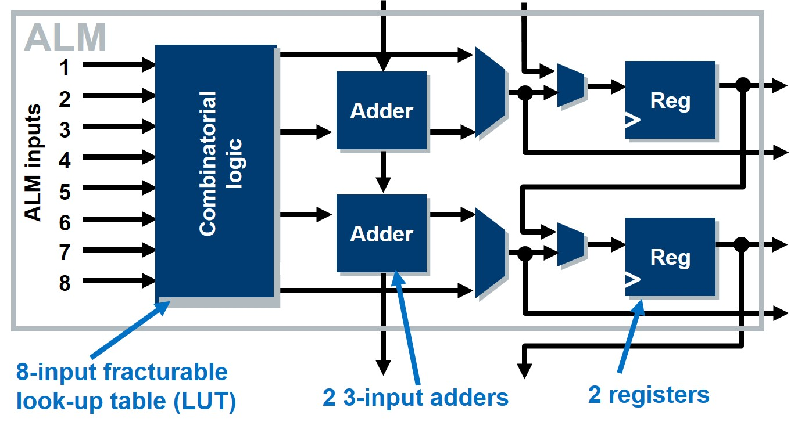
LOGIC ARRAY (Building) BLOCKS
x 10
Notes:
Now that we have discussed the foundations of digital logic, we can begin to see how these circuits can be combined to build custom programmable hardware.
In Intel’s high-end FPGAs we have a unit called an “Adaptive Logic Module” or A-L-M. In this variation of the ALM, there is an 8 input lookup table, 2 adders and 2 registers. The Quartus Prime tools efficiently synthesize your hardware description language into these adaptive logic modules, deciding what logic function gets mapped to the combinational logic and adders, and whether to synchronize the outputs with the embedded registers or bypass them.
Sets of 10 ALMs are linked together to create a Logic Array Block, or LAB. Most of the occurrences of a LAB in an FPGA are fully customizable, however in order to achieve greater performance for certain common functions, some dedicated LABs will have a different structure. We will learn more about that soon.
It is also important to note that different FPGA vendors build their logic blocks in different ways, or refer to them by different names, so it is beneficial to research the architecture of the specific device you are using.

Slide 12
Building the Array
LABs
Row interconnect
Column interconnect
Segmented interconnects
Notes:
In order to build the array, as referenced in the name “field programmable gate array” the logic array blocks we learned about in the last slide are arranged in a grid with routing placed in the spaces between the rows and columns, similar to the streets in a large city.
These row or column interconnects may span the entire length or width of the device or only a smaller segment, covering only a few LABs in a row or column. These segmented interconnects allow for greater power efficiency in the final design.

Slide 13
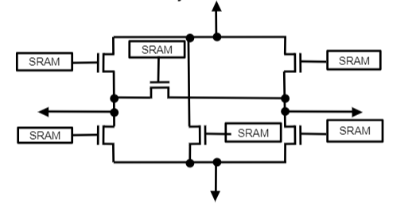
How its Programmed
Row/Column Interconnect Junction
Programming info stored in a external non-volatile device
Active: programmed automatically at power-on
Passive: Intelligent host (CPU) controls programming
Notes:
This is an example of what it might look like at the transistor level where a row and column interconnect meet. The 1 and 0 values stored in the SRAM “direct” the signals from one wire segment to another to connect to neighboring lookup tables.
The SRAMs are volatile, meaning that they don’t hold their values when power is lost. The programming information about your design is stored in an external non-volatile device and programmed automatically at power-on, called “active”, or an intelligent host, such as a CPU in your laptop, controls programming.
If you are using the DE10-Lite board to complete the lab, you will notice that you have to reprogram your FPGA every time you reconnect it to your computer.

Slide 14
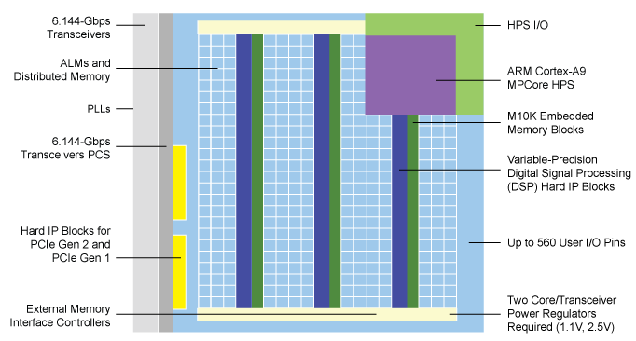
Modern FPGAs
Source: https://www.altera.com/products/fpga/cyclone-series/cyclone-v/features.html
Notes:
This diagram shows the architecture of the Intel Cyclone V FPGA device. As you can see, modern FPGAs are much more complex than basic LABs & interconnects. There are many specialized blocks that are optimized for certain common system functions such as PLLs, or phase locked loops, which are used to generate derivative clocks. Some blocks may even be fully-hardened meaning they cannot be configured, such as the PCIE Hard IP shown above.
In addition to the programmable core logic there is also, Programmable I/O, Programmable Memory, Programmable DSP and an ARM Cortex A9 CPU Hard Processor System, or HPS.
Programmable I/O allows you to easily define your system inputs and outputs, as well as bi-directional signals, with many different custom settings such as differential signaling, current drive strength, slew rate, and more.
Programmable memory blocks can be constructed as different types of memory devices, such as single or dual port RAMs, programmed ROMS, and they can even be used as shift registers or first-in-first-out buffers in place of LAB logic. Since FPGA memory blocks are programmed just like other structures in the device, they can be initialized with any memory contents desired at power-up. This is extremely useful for design debugging since any memory pattern can be initialized and tested.
The other type of dedicated resource block typically found in a modern FPGA device is called a digital signal processing or DSP block. The DSP block contains embedded multipliers and adders to perform arithmetic and multiply/accumulate operations. They can be used instead of ALM logic to improve arithmetic performance in a design.
Some devices also feature high-speed transceivers. These I/O structures support high-speed protocols with transfer rates in the gigabit per second or higher range. These high transfer rates are typically used for communication and networking devices. Intel devices support dozens of I/O standards used in a variety of different applications. Common uses of the transceivers are connectivity to Ethernet or PCI Express.
Different FPGA devices contain different amounts of these types of specialized resources. The device handbook should always be consulted to determine if a particular device provides enough resources for a given design.

Slide 15
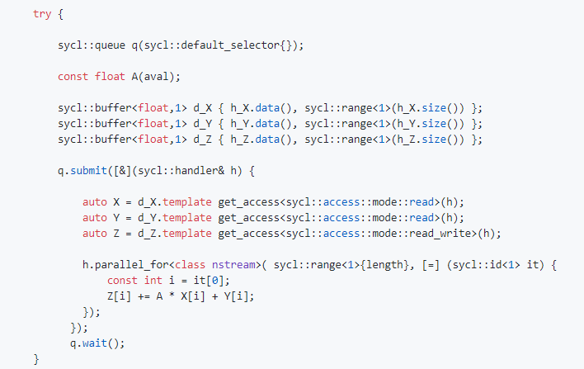
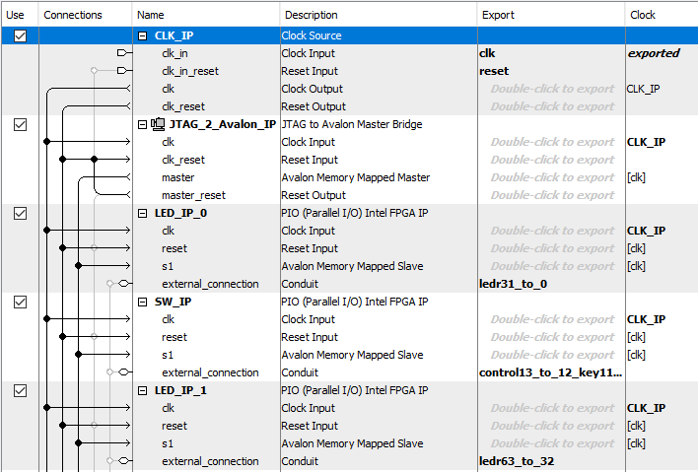
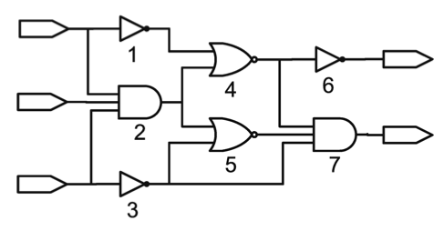
Describing FPGAS
Schematics
System Integration Tools – predefined blocks
Hardware Description Languages (HDLs)
Verilog, VHDL are most popular
Other high level languages
“HLS”
OpenCL
Data Parallel C++
A
Y
B
Y = ~(~(~A | (A&B&C)));
Z = (~(~A | (A&B&C))) & ((A&B&C) | ~C) & ~C);
Z
C
Notes:
Now that we have learned what’s inside an FPGA that is available for us to use, we can begin to learn to how describe our designs. There are many different ways that you can describe electronics. There are state machines, gate-level schematic diagrams, higher-level IP block diagrams, hardware description languages (or HDLs), and even other high level languages such as “C” or OpenCL.
As of now, the most popular way is hardware description languages, with Verilog and VHDL being the two most commonly used. These languages look a bit like C or some other languages you might be familiar with, but they are unique in that they explicitly include the notion of time, a primary attribute of hardware. In addition, processes described in HDL are concurrent whereas most software programming languages are procedural. This means that HDLs can model multiple parallel processes that automatically execute independent of one another and any change to a processes input automatically triggers a calculation.
If you think of a simple button-to-LED design, this means that you can press two hardware buttons simultaneously and they will operate independent of one another. You do not have to wait for one to complete before the next begins as you would have to if they were buttons in single-threaded software.
When we speak of compiling code written in HDL, the tools are completing logical synthesis, a process of transforming the code into a physically realizable gate netlist.
In recent years, high-level synthesis has become a popular way to make it simpler to design FPGAs without needing to learn an HDL. One of these is called OpenCL, which is a framework for writing programs that can execute across many different platforms such as CPUs, GPUs, FPGAs and more. You can learn more about using OpenCL with Intel FPGAs in some of our advanced training courses.

Slide 16
What is IP (INTELLECTUAL PROPERTY)?
Complex functions that Intel designs for our customers so they don’t have to design it themselves
Sometimes IP is free
The more complex stuff costs since its expensive to develop and make sure it works
Examples: Ethernet Controller, PCIe Controller, soft processor, multiplier functions, etc.
Notes:
IP, or intellectual property, is another important tool for describing electronics. These are complex and commonly used functions that Intel has provided for you to use in your designs so that you can focus your energy on implementing your unique ideas.
An example would be if you are developing an embedded system that communicates via Ethernet, you don’t have to spend time inventing your own Ethernet controller.
Most IP packages are configurable, meaning you have some degree of flexibility to describe how it should be set up before it is synthesized as part of your design. Intel offers many different IP blocks for free, but others require a license.
You can explore the IP available to you to use in the IP Catalog within Quartus.

Slide 17

Intro to Quartus
Intel® Quartus® Prime Design Software is a tool for FPGA, SOC and CPLD design
Includes synthesis, debug, optimization, verification and simulation
Takes a description of an FPGA (schematic or HDL) and determines how the lookup tables are programmed
Many formats to program an FPGA
In this class we will use a “.sof” file (SRAM object file)
The .sof file is “volatile” and needs to be reprogrammed every time the board is restarted
Notes:
Now we are ready to begin designing. Intel® Quartus® Prime Design Software is an all-encompassing tool that can be used to design and test FPGAs. You can input your design either as a schematic or in HDL code, though for complex designs HDL is much more efficient. The tool also includes tools that allow you to easily instantiate pre-existing IP or you can create your own if you have a process that you regularly use in many designs.
After you describe your design in HDL you will compile your design. This step includes synthesizing a netlist and then using place and route algorithms to determine the best LUTs and logic array blocks for each component of your design. Once your design is compiled you can verify that it meets all the timing requirements for your hardware, which we go deeper into in a later workshop. In today’s lab, your design is not complex enough to experience timing challenges.
The output of this process is a .SOF file that can be loaded onto your FPGA hardware. The DE10-Lite does not have any external memory so you will be programming it via USB from your computer, and will need to do so every time you disconnect the board. With more advanced hardware, the design can be stored in memory such as an SD card or on-chip memory.

Slide 18
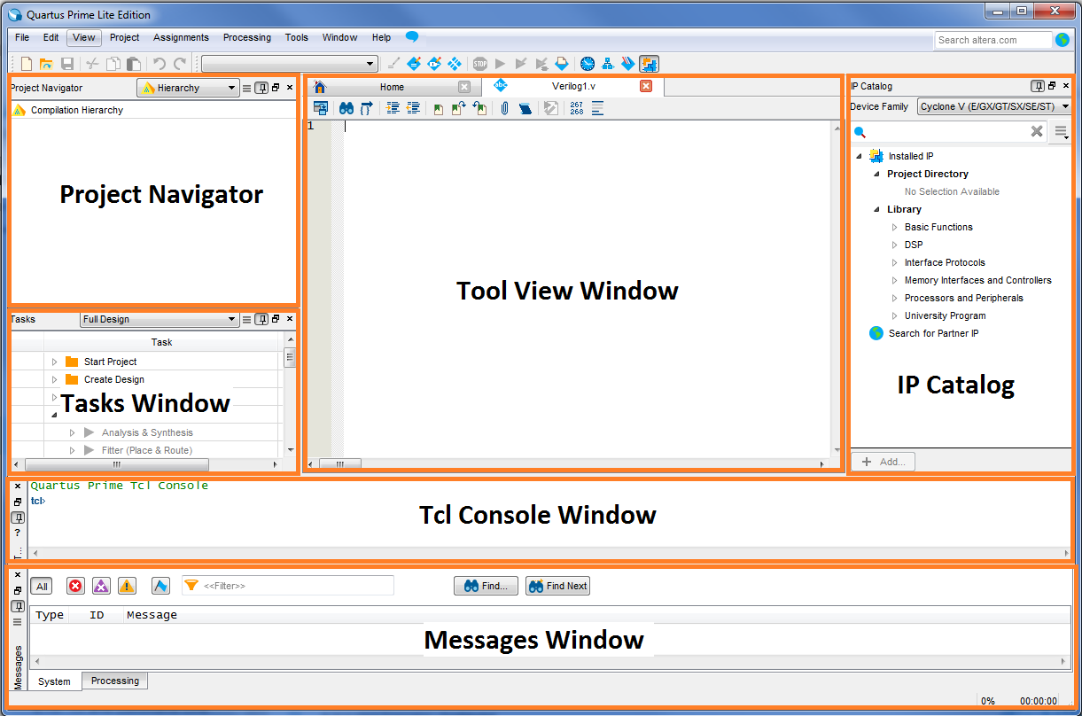
Quartus User Interface
Quartus Prime Software Main Window
Project Navigator shows your project hierarchy, source files, design units, IP and design revisions in your project.
Tasks window shows the status of the design and can be used to run or re-run parts of the design flow
Messages window outputs messages from each process of the run.
Files window has tabs for the report browser, open design files and any other file opened by the user.
IP Catalog window is open by default and is used to generate IP functions that are to be used in your design.
Project Navigator
Files Window
Tasks Window
IP Catalog
Messages Window
Notes:
This is a screen shot of the GUI for Quartus. This default view is composed of six widgets, all of which can be re-sized, minimized, moved, or even dragged out to their own window.
The first is project navigator which shows the project hierarchy, the source files, design units and IP in the project
The second window is the tasks window. Here you can view the progress of the various steps when you are building your design, such as the sub-phases in the compilation process.
Next is the T-C-L, pronounced “tickle,” console window. Tcl is a very simple scripting language which can be used to automate clicks within a GUI environment, among other things. In our lab we will use it for speeding up the process of making the I/O pin assignments for our design.
Next is the messages window where the Quartus displays message about your design, such as errors and warnings. You can filter this window to show only certain types of messages which is helpful during debug.
In the center is the Files window. This window is used for the report browser as well as opening files for viewing. For example the source code editor will open in this window so that you can type your HDL.
Finally we have the IP catalog which is used for instantiating IP within the Quartus tool. When you are finished generating IP you will generally close this window.
The lab manual for this workshop provides clear instructions on where to find everything you need.

Slide 19
Tools Overview
Design Files
EDA Libraries
Analysis & Elaboration
MAP
Constraints & settings
Synthesis
Functional Simulation
Functional Netlist
Fitter
HW Debug tools
Programmer
SignalTap™ II logic analyzer
SignalProbe
Assembler
TimeQuest
Timing Analysis
Programming & Configuration files
EDA Netlist Writer
Gate-Level Simulation
Post-Fit Simulation Files
Notes:
This diagram shows the flow through the Quartus II tools for a typical FPGA design. As a designer, your input to the process comes in two forms. The first is the actual design itself – this will include source files and purchased or generated IP. IP, or intellectual property are prebuilt blocks such as memory controllers, and IO peripherals. The second is tools settings and constraints used to direct the generation of the final FPGA design, including timing constraints such as clock frequencies and IO timing requirements and physical constraints such as pin placements.
The process runs through the steps shown. It begins with synthesis where your source and any IP cores are mapped onto the hardware structures available in the chosen FPGA family. These hardware structures are then placed and routed in the chosen device by the fitter. The assembler generates the required files that are used for programming. Finally, if needed, the TimeQuest timing analyzer is used to check the timing of the final design against the constraints that you have specified.
There are also additional tools to help in hardware debug, like SignalTap. A later workshop in this series will introduce you to simulation and debug with SignalTap.

Slide 20
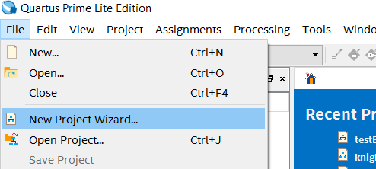

New Project Wizard
Name project
Set Working Directory & Top-Level Entity
Add source files
Select Device
EDA tool settings
All settings can be modified later. Some steps can be skipped.
The top level entity must match the top level module in your design exactly (case sensitive) in order to avoid a compile error.
Notes:
Now we will walk through some of the important steps for creating a project. All these details are also included in the lab manual, but if you want you can pause this course and follow along with your lab one section at a time.
To create a new project, we will use the new project wizard which is found under the “file” menu. The new project wizard feature creates and initializes all of the required files for the project. All settings that are made while running the wizard can be modified later.
First you will set the working directory and top level entity for the project. The top level entity is the module name of your top level design. It is critically important that this name matches the top level module in your design exactly and it is case sensitive. Otherwise, you will have a compile error.
You will then move on to add source files, set the device type and indicate any third party EDA tools that will require files from Quartus. Follow the instructions in the lab manual.

Slide 21
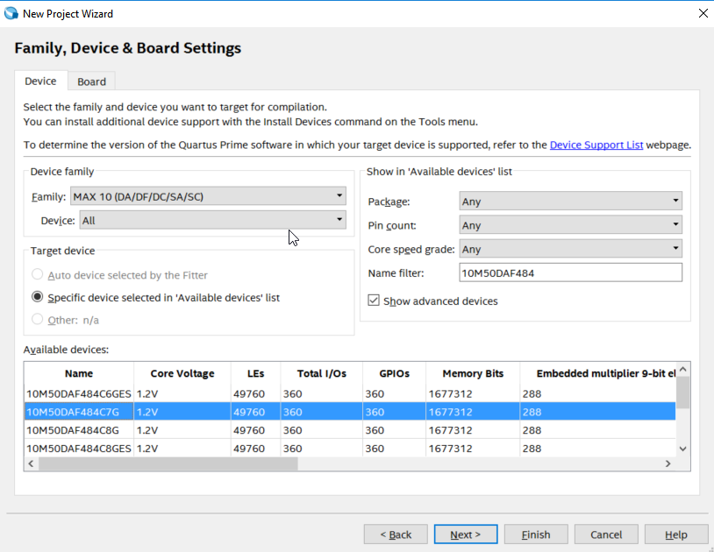
HINT: Family & Device Settings
Expand the window so you can see all the fields
Get the part number for your specific device by looking on the chip on your board or the side of the box.
Notes:
One common problem area is in the “Family & Device Settings” window of the New Project Wizard. If you do not see the full window as it appears here, you may need to stretch the window vertically.
The lab will instruct you to search for your device. Make sure that you are using the part number for your specific device by looking directly on the silicon chip or on the side of the box for your kit.

Slide 22
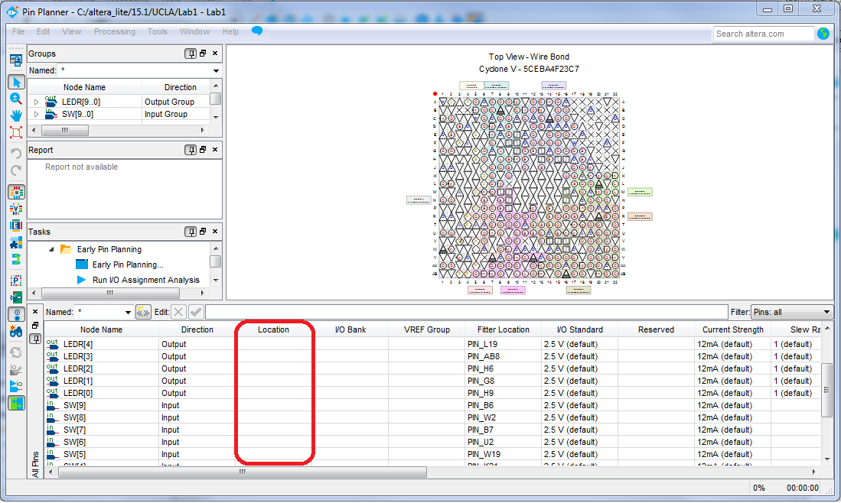
Pin Planner
Notes:
After setting up your project in the New Project Wizard, the lab manual gives you some sample code for your first design. Once the design is described in HDL, you need to assign pins before you can compile.
By default, Quartus does not know how the FPGA pins are connected on the DE10-LITE or other development board to the switches and LEDs used in this circuit. Because our FPGA is already on a PCB we need to tell Quartus what pins to use.
Although Quartus allows you to select a development board with a predefined pinout, the lab shows you how to define a pinout as an exercise for future scenarios where a custom PCB might be used.
In the lab, you need to assign the Switches and LED signals in your code to the appropriate pins, using the main toolbar at the top of the Quartus window, navigate to the “Assignments” drop down menu in the main Quartus toolbar. Click on “Pin Planner” and a window similar to the one shown here will open.
We can see the I/O pins have not been assigned to any locations yet. To make the right pin assignments for this project, we have to look it up in development board vendor’s manual.
You could go to Terasic's DE10-LITE Development Kit website and download the DE10-LITE User Manual under resources, but to make it easier, we have included a snippet of the pin guide in the lab manual.
Assignments are made by matching the signal name to a pin number, and typing that pin number into the “location” column in the pin planner.

Slide 23
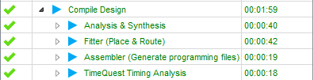
Compile YOUR DESIGN
Warnings shown in blue won’t prevent your design from compiling or being programmed, but they could indicate possible bugs. This lab does not have any design constraints, so the .sdc file is not needed. You will learn how to create one in the timing analysis workshop.
Notes:
When you are ready, click the “play” button located at the top of the main Quartus window to compile your code. If you’ve done everything correctly, there should be no errors shown in red. It is possible that you could have a warning, shown in blue, but these can be ignored for this lab.
If you did get an error, check that your top-level-entity name and top-level-module name match exactly. You may need to back-track through the instructions to find where you went wrong.

Slide 24
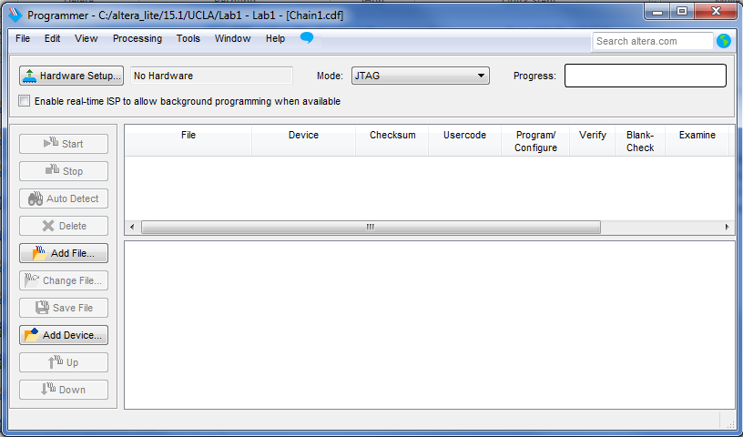
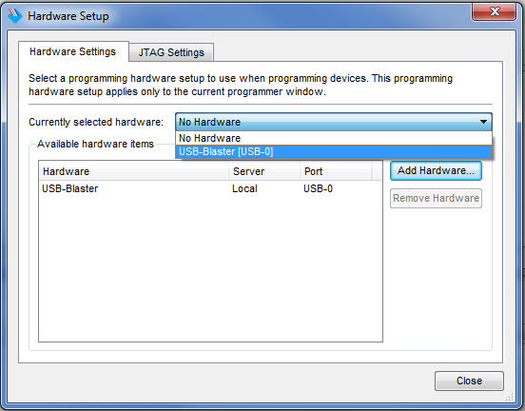
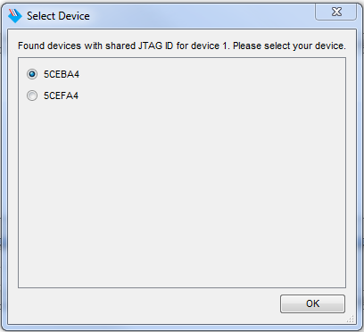
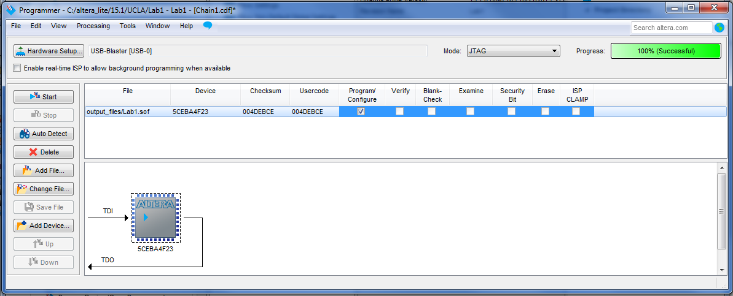
PROGRAM YOUR FPGA
Notes:
To download your completed FPGA design into the device, connect the USB Blaster cable between your PC USB port and the USB Blaster port on your development kit. Don’t forget to also plug the kit into power using the wall adapter if it has one, but the DE10-Lite does not, it’s powered by USB. Upon plugging in your device, you should see flashing LEDs and 7-segment displays counting in hexadecimal.
To use the USB Blaster to program your device, you need to install the USB Blaster driver. Follow the following steps in the lab manual to install the USB Blaster driver.
The next step will take the FPGA “image” and download it to your development kit. Click “programmer” under “Tools” then choose “Hardware Setup” on the top left corner. In the window that appears, use the drop down menu to select USB Blaster. You cannot just click where it appears in the available hardware list. If you close out of this window and it still says “No hardware” next to hardware setup, you did not select it from the dropdown list. If USB Blaster does not appear in the drop down list, your drivers did not install correctly.
Next you will add the sof SRAM Object File to your programmer. Follow the instructions in the lab manual. Finally, click “Start” and you should see the default lights on your board turn off once the programming is successful.

Slide 25
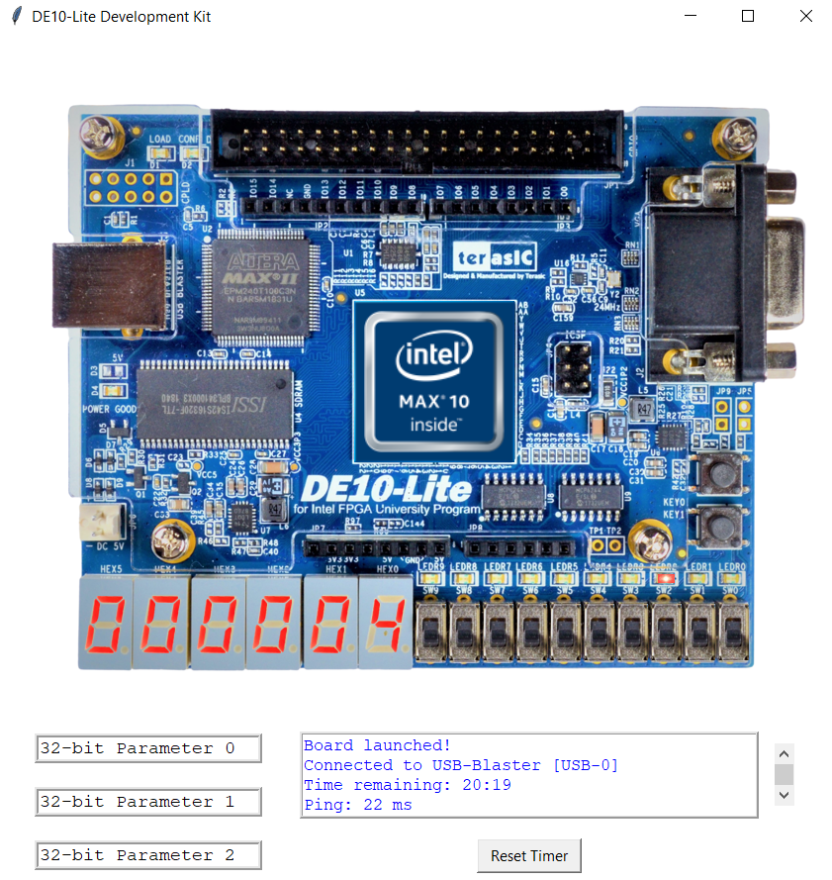
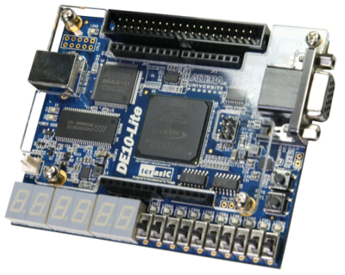
TEST YOUR DESIGN
Live Hardware
Remote Console
Notes:
Now you should be able to control the LEDs with each switch. Toggle the switches to test your design.

Slide 26
Covid-19: New challenges for remote learners
In June 2020, we launched initiatives to help remote learners
Addresses situation where student does not have a physical board in their possession
Simulation based only requires Modelsim
Quick compiles
More setup with IP
Slower clock speed
Hardware based requires Intel Quartus Prime-Lite
Longer compiles, but hardware accurate
More complex networking, adds a level of hierarchy in the design

Slide 27
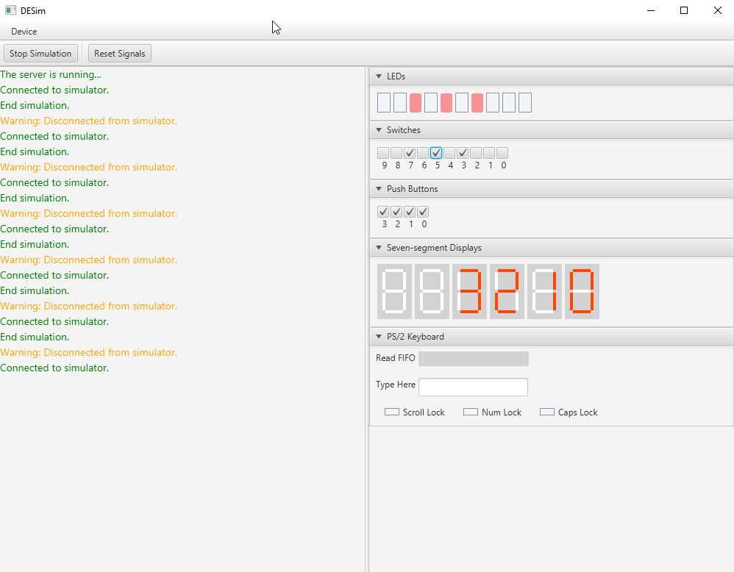
Simulation Console for FPGAs
Supports: Switches, Push Buttons, LED, 7-Segments, PS2 character i/f and VGA Display
Modelsim mimics behavior of board
Good for initial bring-up and debug
No need for viewing waveforms

Slide 28
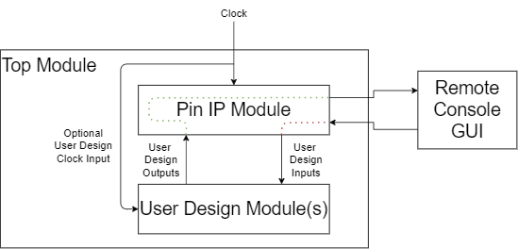
Overview
Support for remote GPIO-based labs.
Good for undergraduate curriculum.
Leverages existing Quartus Prime Lite installation.
No additional software needed.
Up and running in minutes.
Requirements:
Windows machine
Quartus Prime Lite
Access to local or remote development kit

Slide 29
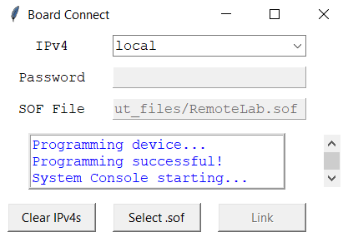
Connecting to Development Kit
Right-click launch task
Select "Start"
If development kit is locally connected keep IPv4 as "local"
Otherwise a host's IPv4 and password are used.
Select project .sof.
Link

Slide 30
New Remote Console Projects
Download the blankProject.qar example project for your dev kit.
Unarchive the project into Quartus.
Add source files and connect new design to top-level wrapper.
Debug and compile.
Launch Remote Console and validate functionality in hardware.

Slide 31
Hosting Development Kits
Requirements:
Linux Ubuntu 18.04
Static IP assignment
Enough USB connections (supports USB hubs)
Quartus Prime Lite Programmer and Tools package
Clients with VPN privileges
Run setup bash script as root
Distribute IPv4/passwords to clients
Saved in jtag_server_passwords.txt

Slide 32
FIRST LAB: SWITCH TO LED
assign LED = SW;
10

Slide 33
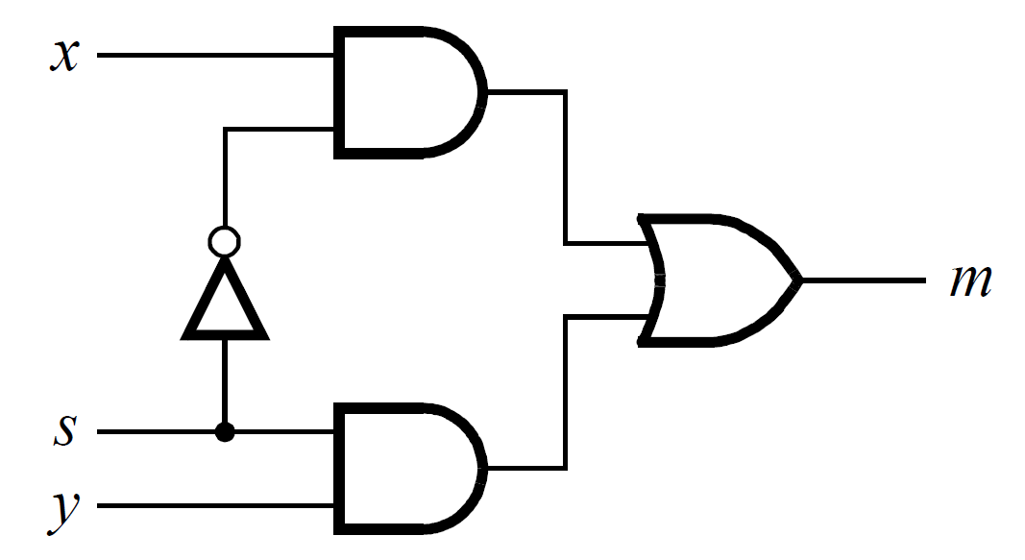
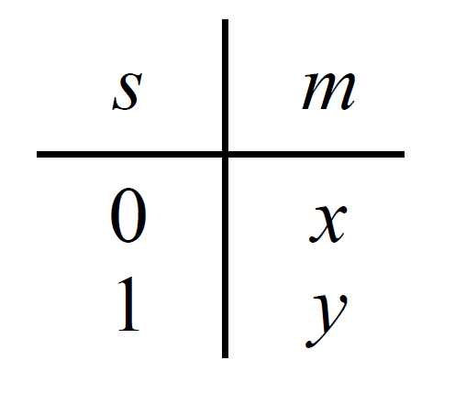
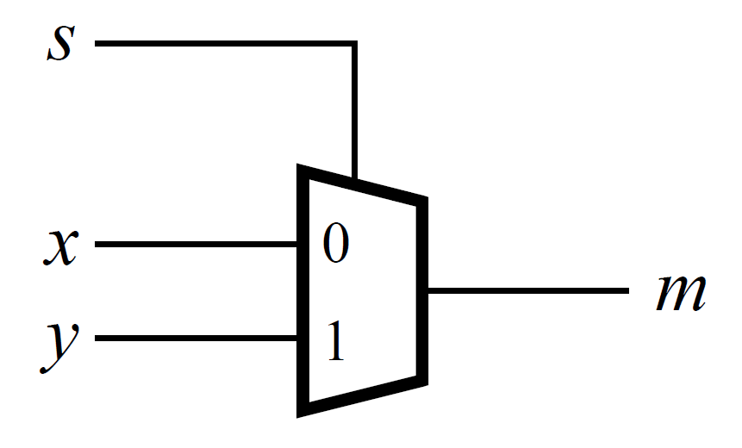

Next LAB: Multiplexer
Circuit
Truth table
Symbol
The multiplexer can be described by the following Verilog statement:
Notes:
Congratulations on completing your first FPGA project. Now you can continue through the lab to build a 3 bit wide 2-to-1 multiplexer like the one we discussed at the beginning of this workshop. Note that the switches are used as inputs to the 3 bit wide 2 to 1 multiplexer circuit. The values of the switches are displayed on the corresponding LEDs and the output and select line are also displayed on the LEDs. Read your Verilog code carefully to determine how the switches correlate to the multiplexer circuit and make sure you understand how it functions on the development kit.

Slide 34
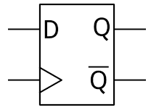

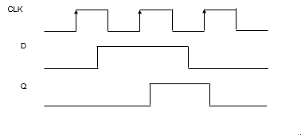
KNIGHTRIDER
Notes:
Once you have compiled, programmed, and tested your 2-to-1 mux, you can move on to the final part of the lab which is using counters and clocks to implement a light sequencer. We call the lab “Knight Rider” as this was a popular TV show in the early 1980s that had a crime fighting car that had a light sequencer on its front grill.
This lab will introduce you to sequential logic and flip-flops. Let’s quickly review how flip-flops work.
Flip-flops are basic storage elements in digital electronics and are essential a single bit of RAM. In their simplest form, they have 3 pins: D, Q, and Clock. The diagram of voltage versus time (often referred to as a waveform) for a flip-flop is shown. Flip-flops capture the value of the “D” pin when the clock pin transitions from low to high. This value of D then shows up at the Q output of the flip-flop a very short time later.
The Knight Rider lab sequences the 10 LEDs sequentially at about 1/10 second per LED illumination. The code provided in the lab manual has some intentional bugs so that you can practice working with a hardware description language and try out your debugging skills. Follow along with the lab manual to create the project files, assign your clock pins, and debug your code.

Slide 35
FINAL TIPS
When Quartus Prime Lite first starts for the very first time it might ask you about purchasing a license, select Run Quartus, all licenses are free for this lab.
If things fail to compile, check your top Level Entity Setting → Setting → Top Level Entity and make sure that the module <design> matches your top level entity, including case.
Check the LEDR[0] and LEDR[9] pins carefully in the Knight Rider lab and see if they sequence properly. If not, study the code carefully!
Sometimes copy and paste from files into Quartus has carriage return formatting errors. If you see run on lines with no carriage return, you need to copy things over line by line, or add the appropriate file to your project. It’s better to click on the links and download the files.
Notes:
Here are some tips to keep in mind when running through the lab manual. When you launch Quartus you will be offered three selections, just select the run Quartus option. In the future if you need more features for Quartus such as advanced IP or higher end products, you might need to purchase a license.
All these tips are also highlighted in the lab manual. Please follow the lab manual instructions carefully and pay attention to upper and lower case text as file names and the Verilog language are case sensitive.

Slide 36
Notes:
Thank you for joining us for Introduction to FPGA Design in Quartus. We hope you enjoyed this online course. To learn more or find other trainings please the visit the Intel FPGA technical training or Intel FPGA University websites.

